Slide 1
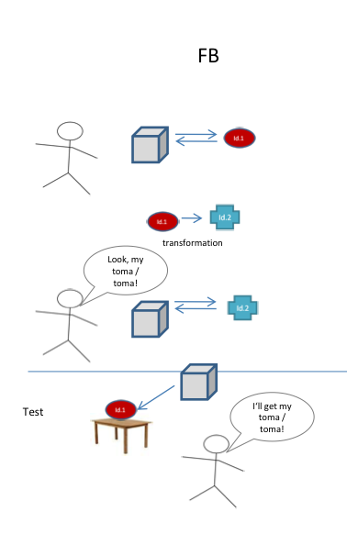
:identity
TB
Look! A toma!
Look! A toma!

Slide 2
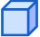
:identity
:location
Look! A toma!
Look! A toma!
unexpected transfer

